Slide 1
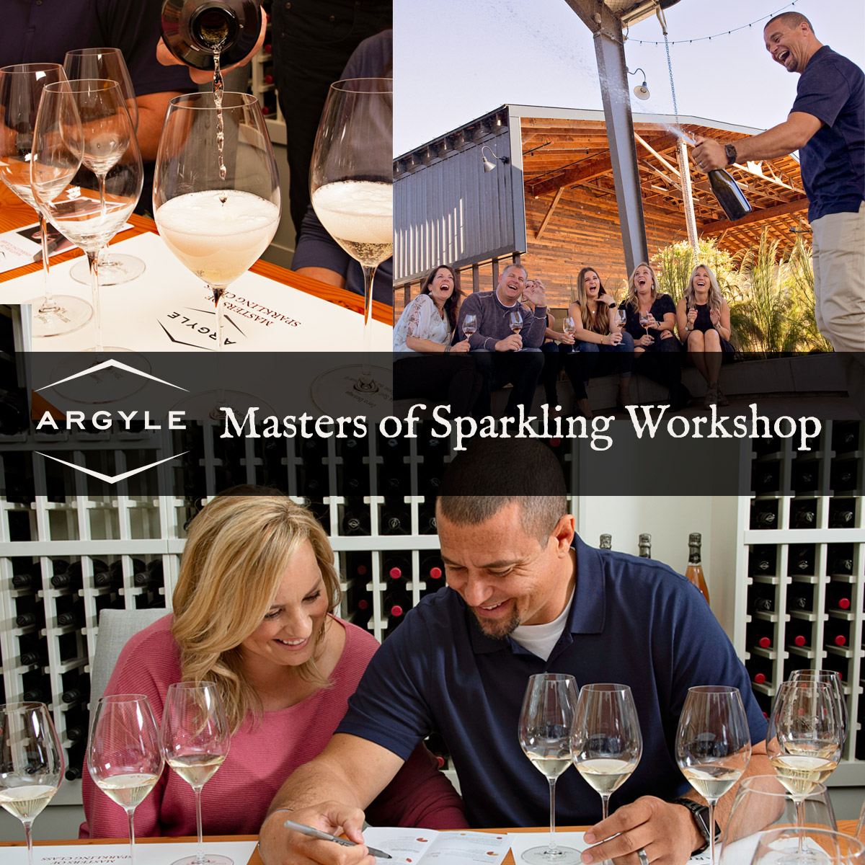

Slide 2
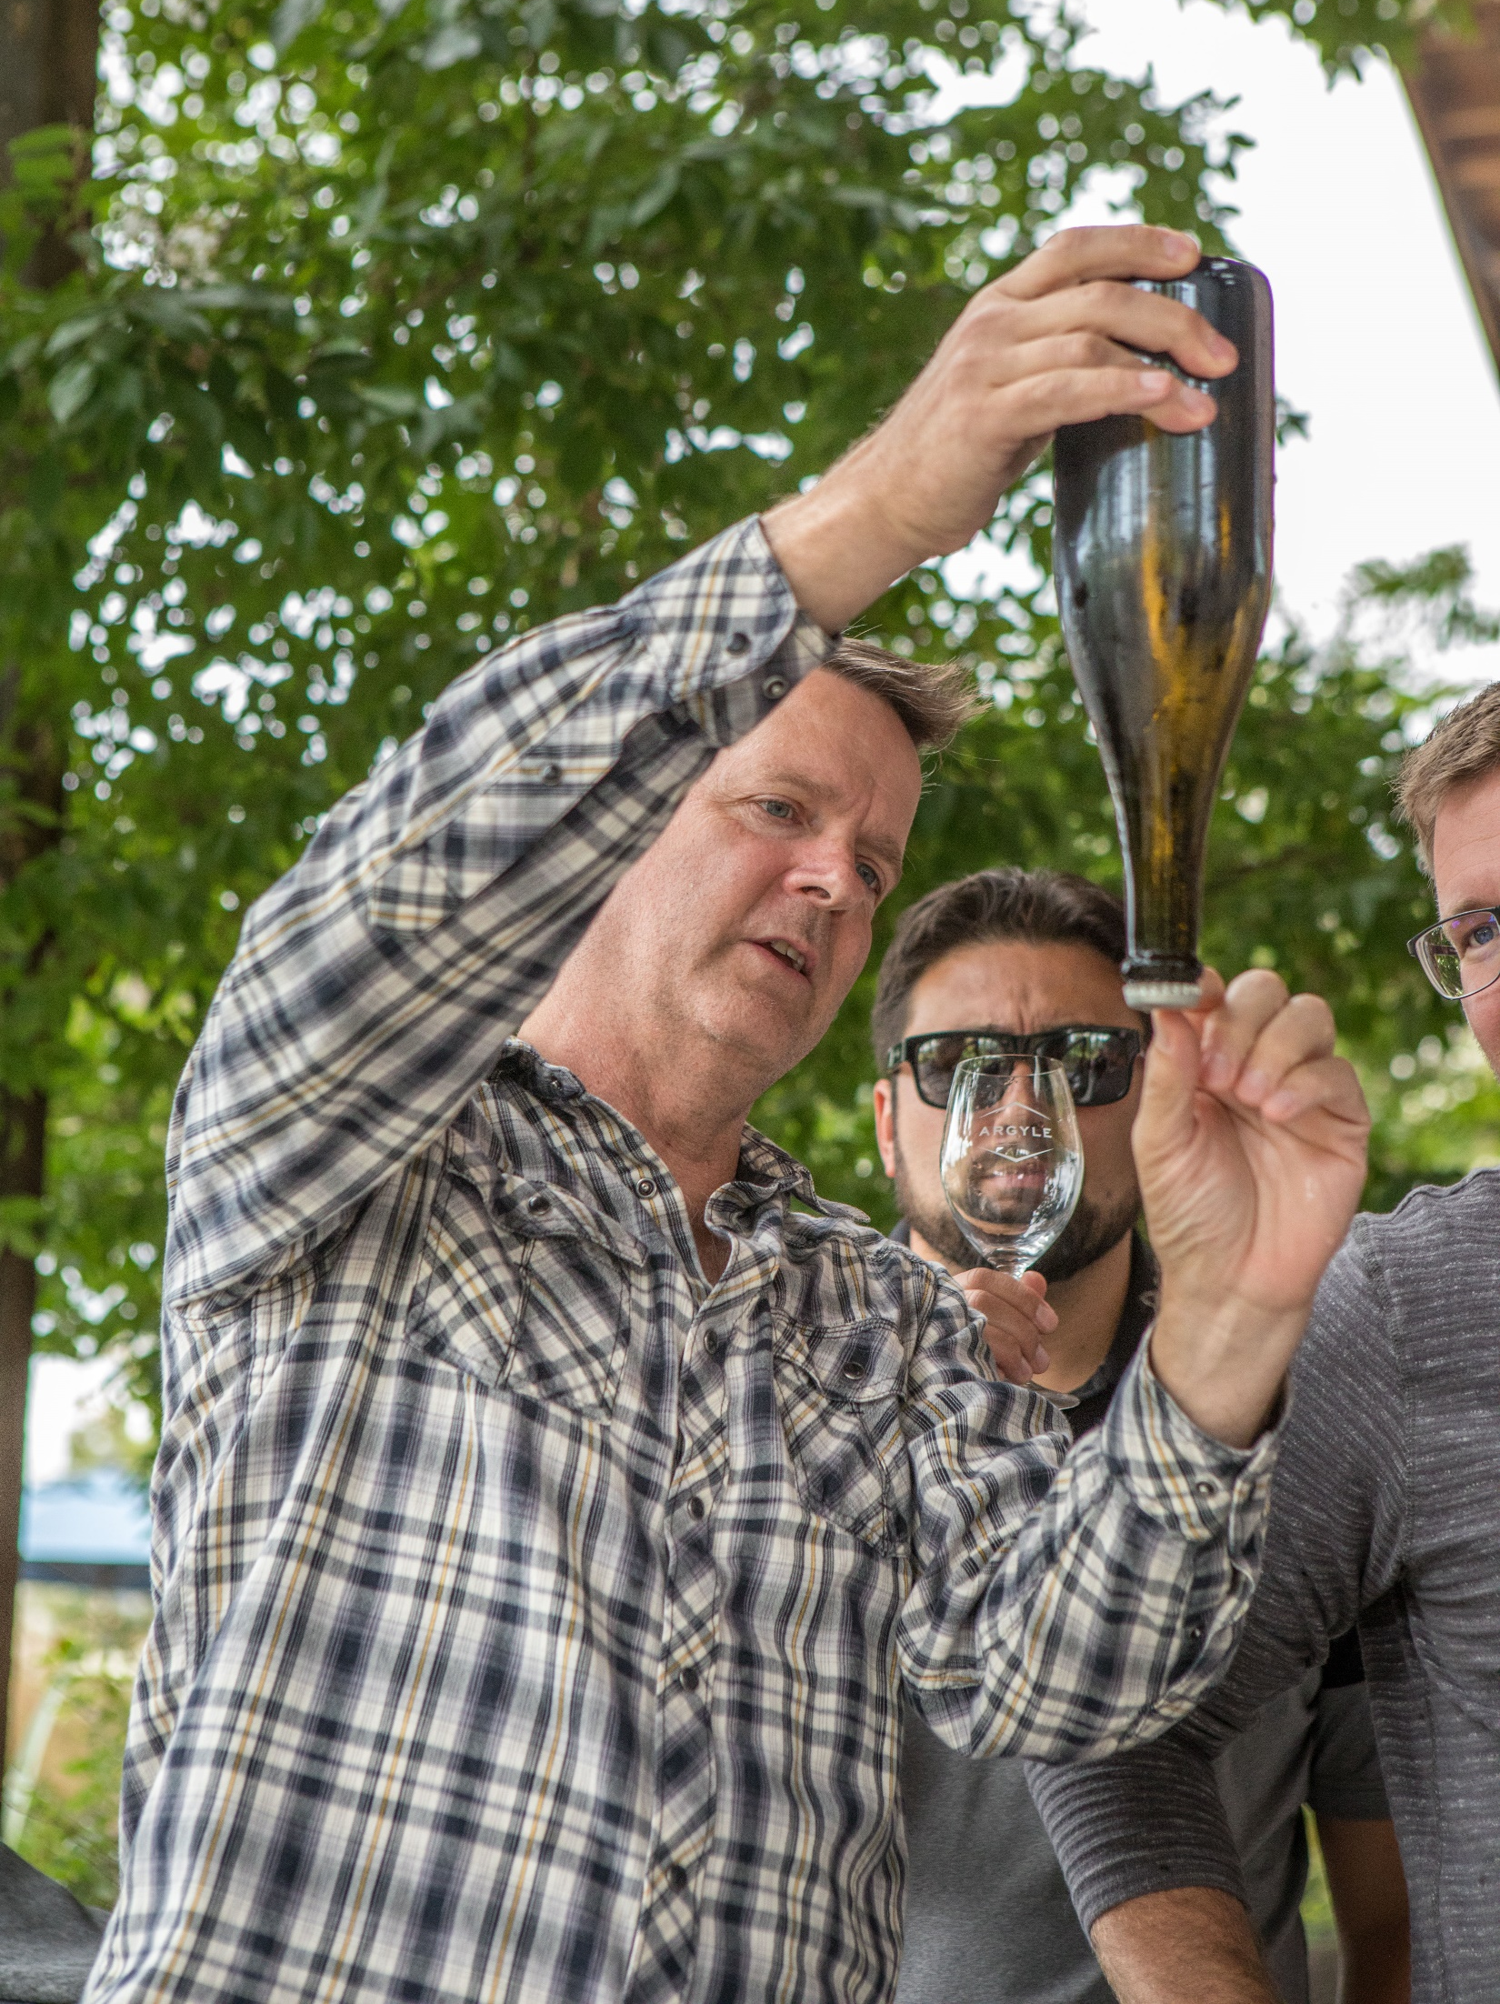
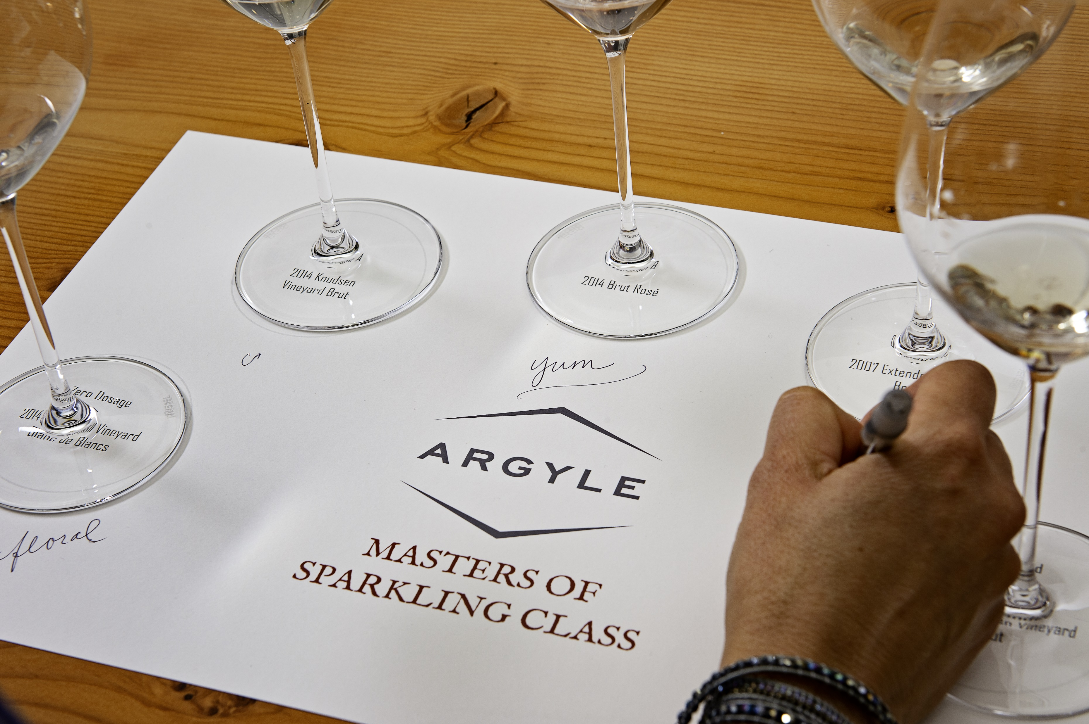
Overview
Argyle’s Masters of Sparkling Disgorging & Dosage Workshop provides everything you need to conduct a session demonstrating these two important steps of the sparkling wine process (disgorge & dosage).
This experience is designed to help you engage and educate your valuable customers in an intimate and interactive setting as well as sell finished Argyle sparkling wines.
The workshop includes:
A disgorging demonstration (invite a guest to give it a try!);
A dosage trial flight to taste various levels of dosage including what was just disgorged, concluding with the final blend;
A second flight of finished sparkling wines from Argyle such as Blanc de Blancs, Brut Rose, Blanc de Noirs or Extended Tirage; and
Take-home materials, including a tasting mat and informative bookmark describing all of the steps of the sparkling wine process.

Slide 3
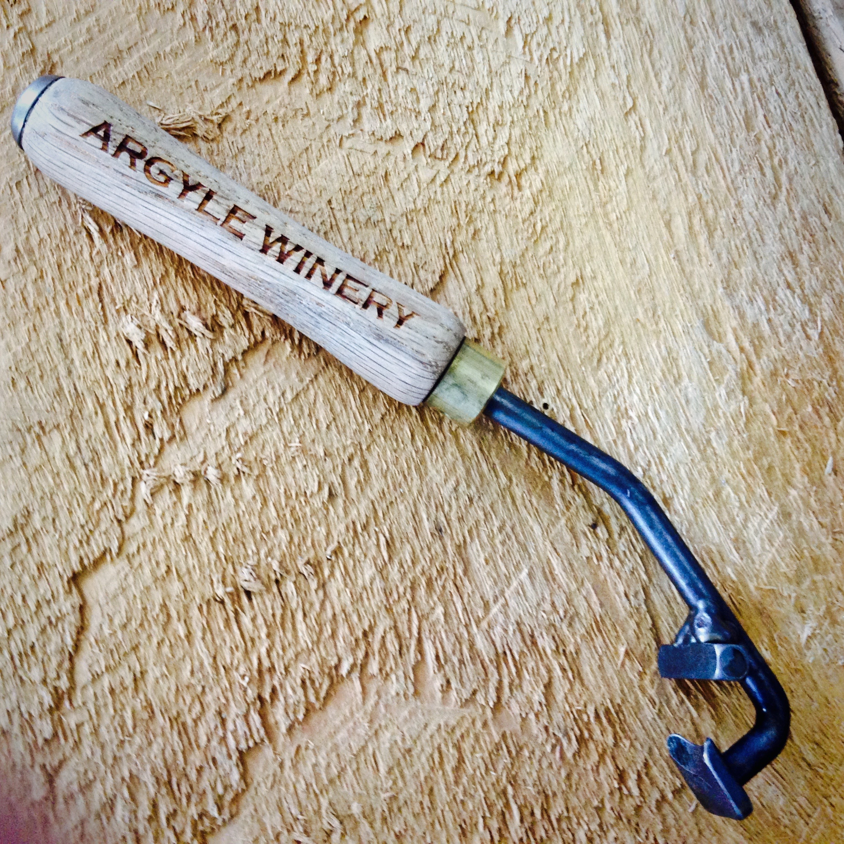
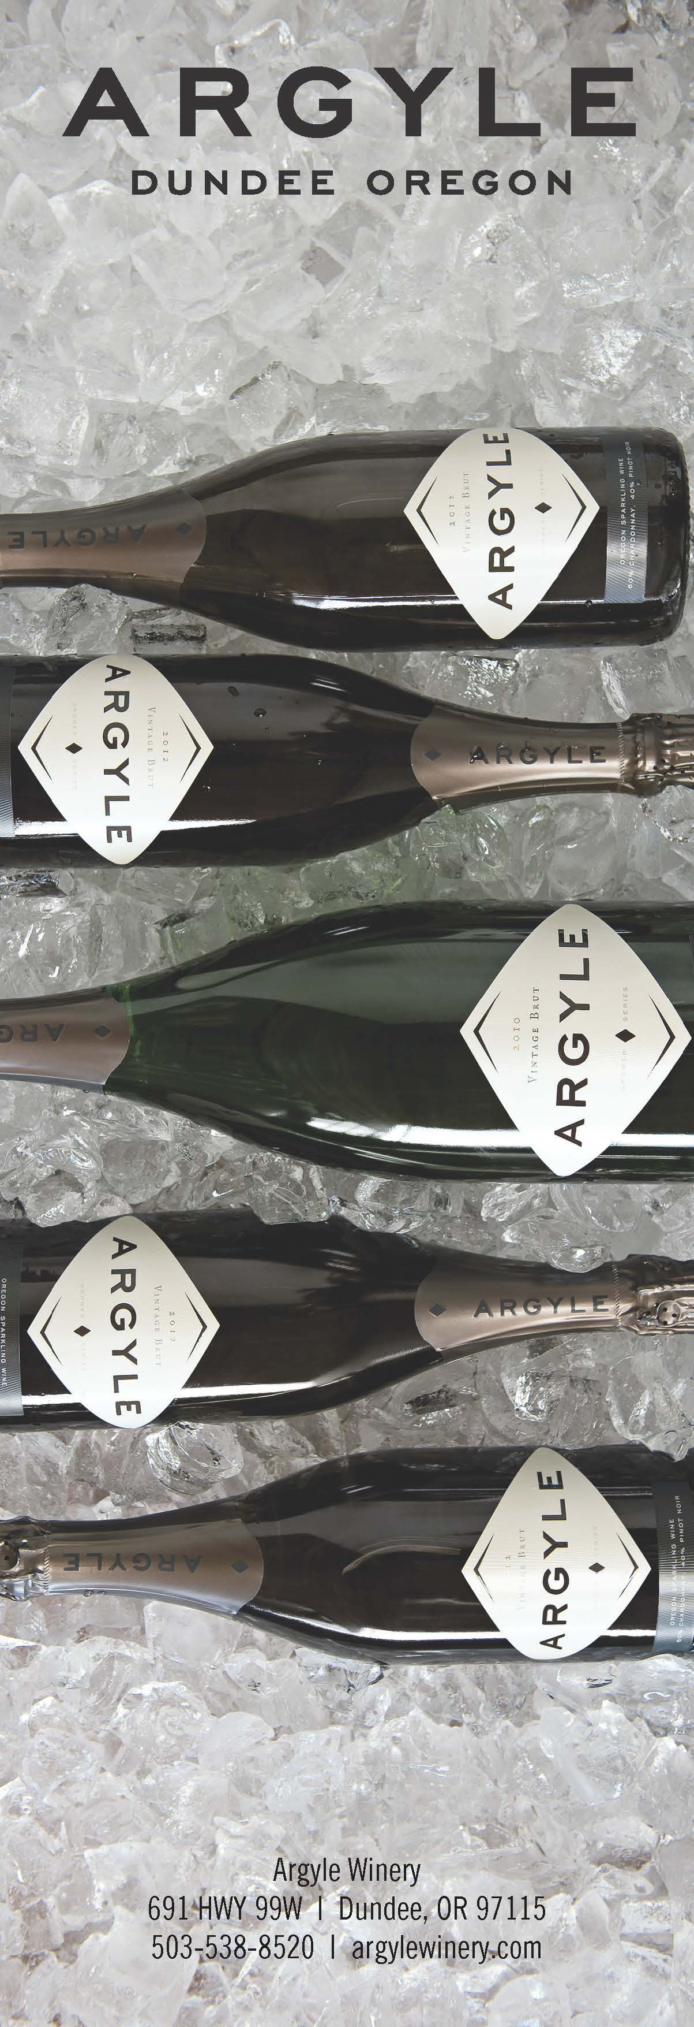
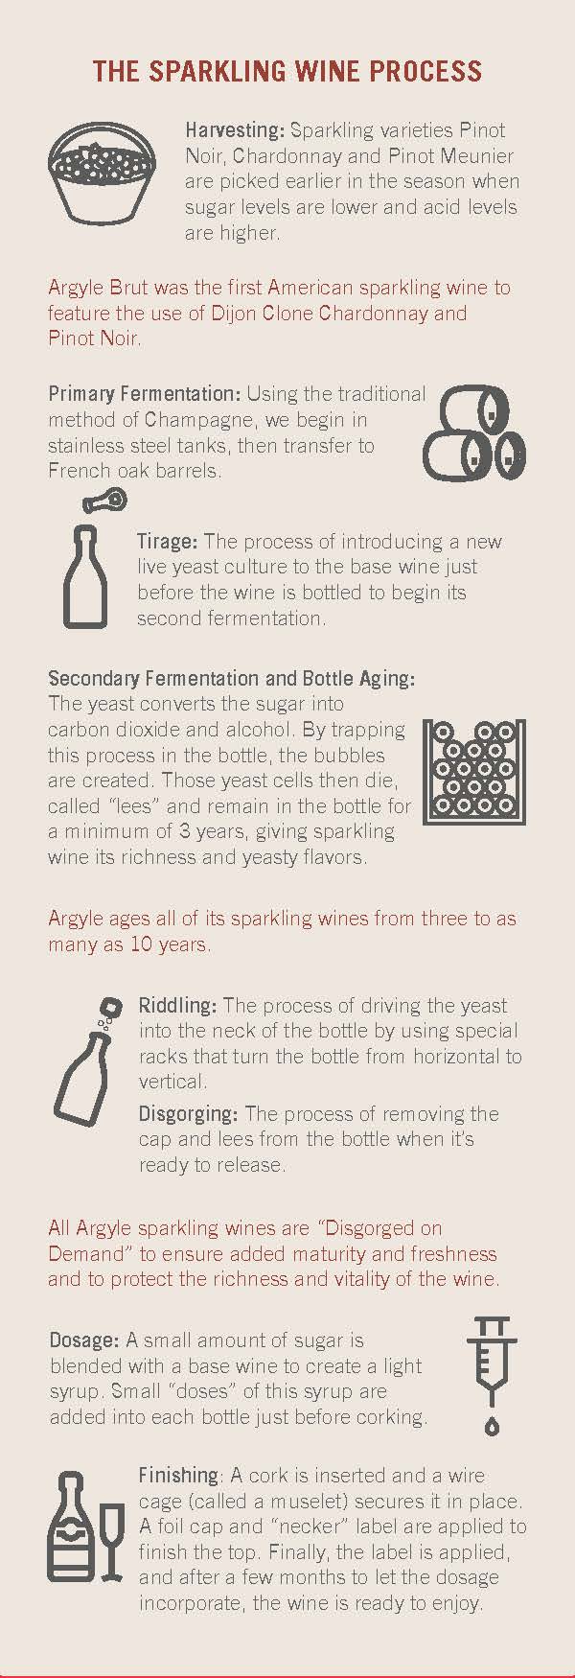
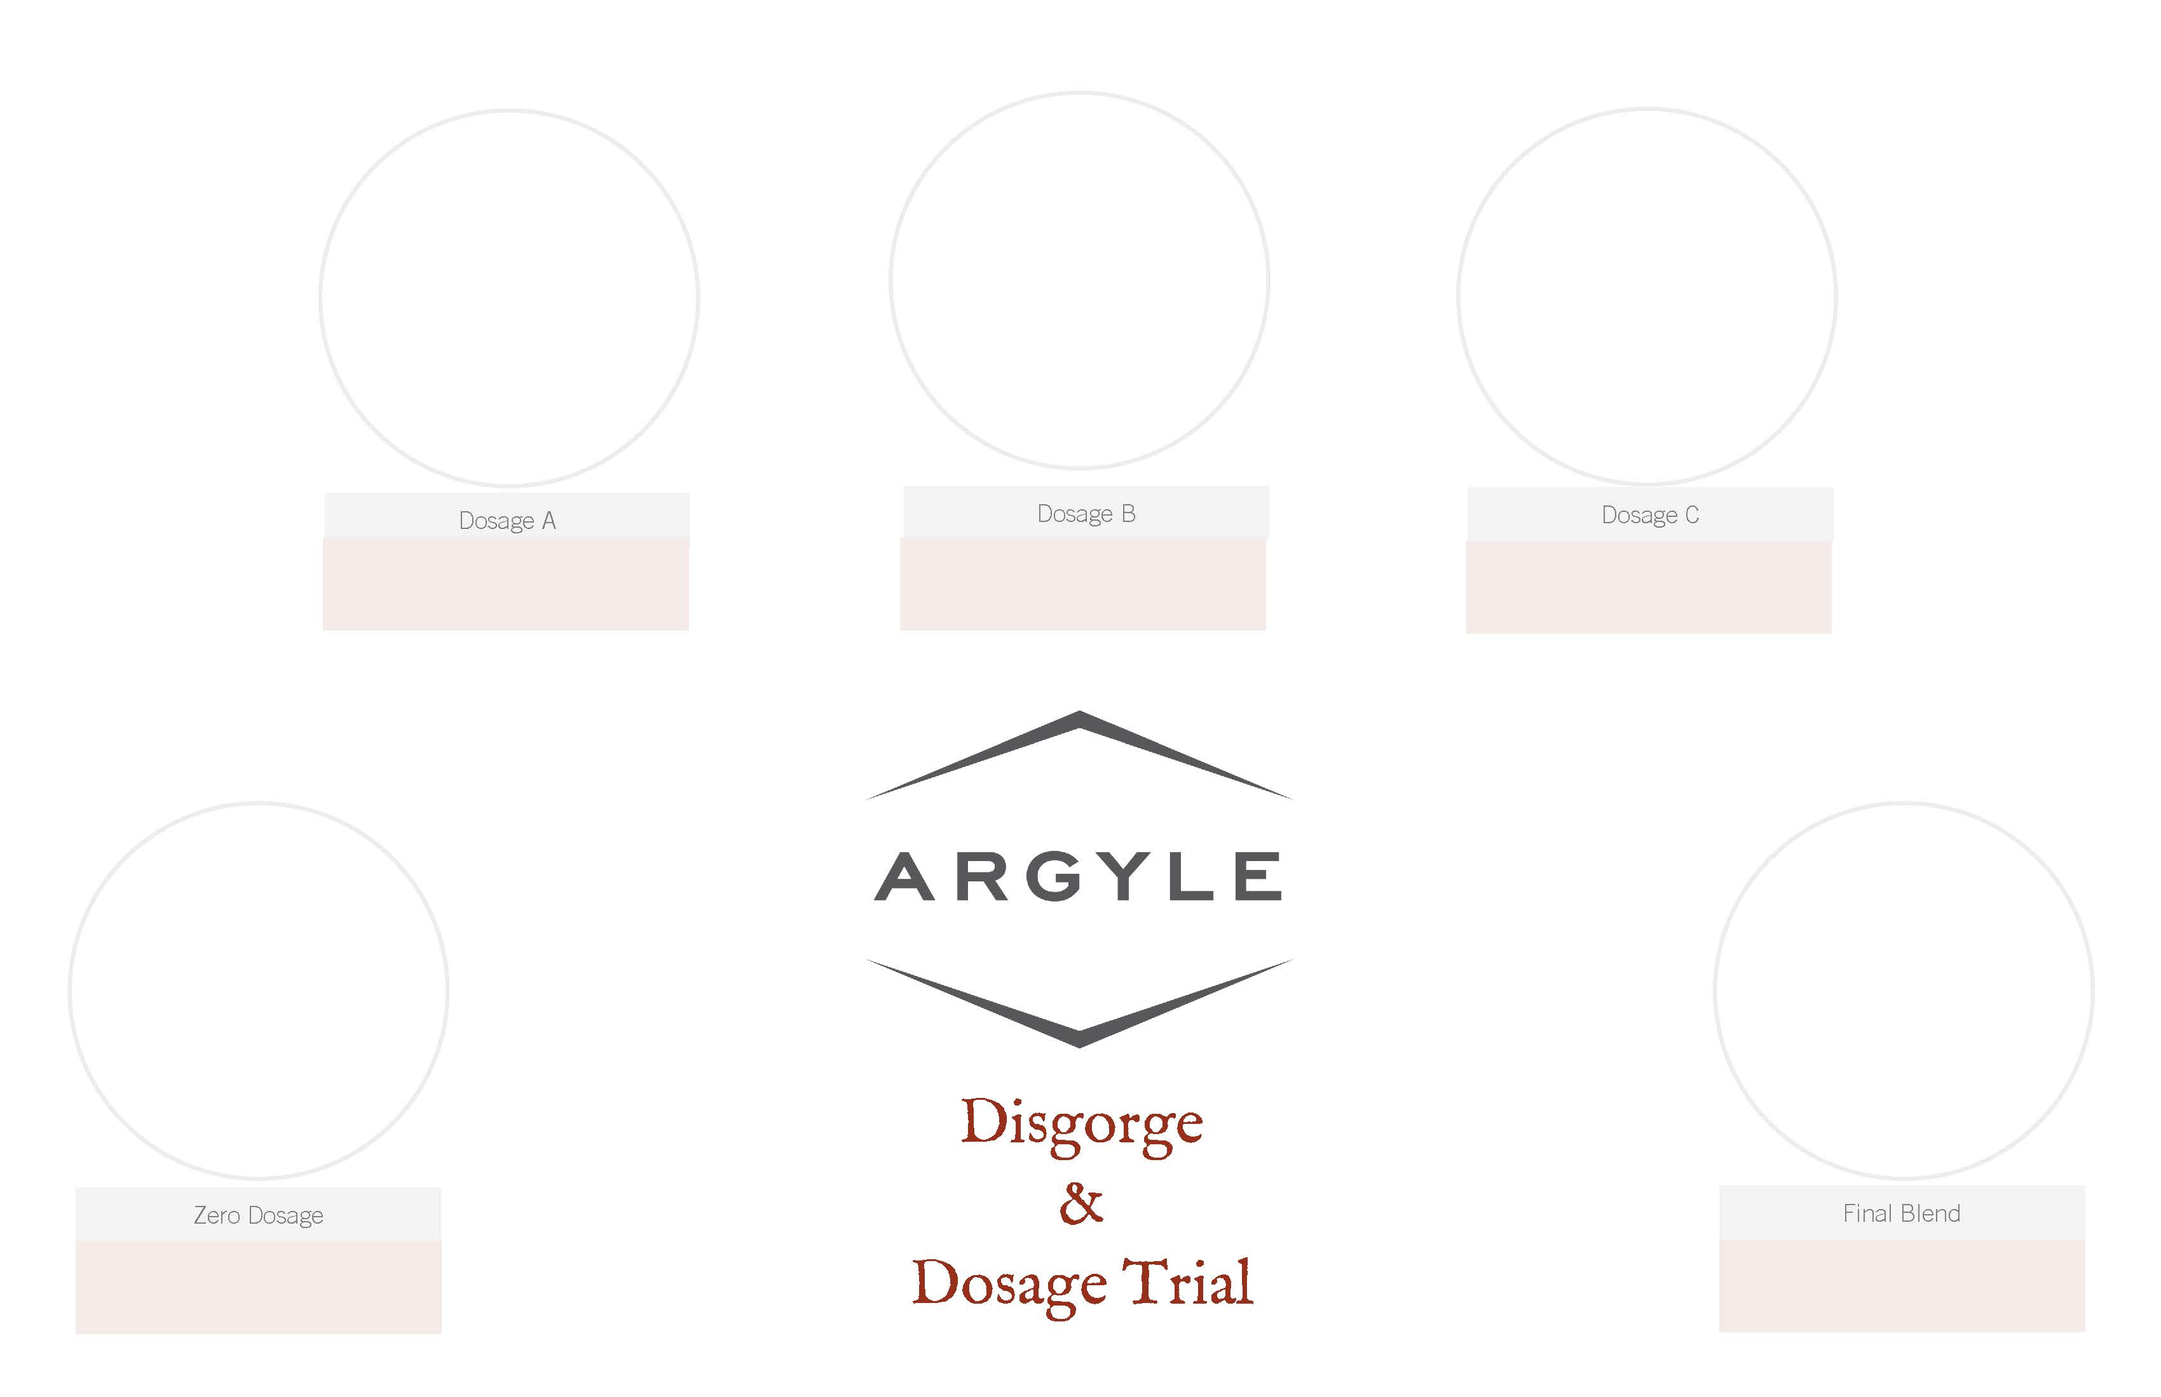
The Kit
Online at https://argylewinery.com/trade/winemaking/, you can download:
This presentation
A graphic to promote the workshop
Tasting mats to print
Once a date, time and location are set for your workshop, we’ll ship a kit to you which will include:
Non-disgorged Argyle Vintage Brut as well as bottles with various dosage levels
One of the dosage levels will be the final blend from that vintage
Hand-crafted Argyle hand disgorging tool (which must be returned)
Support selecting other Argyle sparkling wines in your inventory for bubbles flight two
Sparkling wine process bookmarks for participants to take home

Slide 4
Steps
What | Tips and Notes | When
Determine a date and location for the workshop | We recommend approx. 10-12 participants, and remember you’ll need an outdoor area with open space for the disgorging demo | At least 6 weeks prior
Contact craig@argylewinery.com to coordinate delivery of your kit | Time is required for shipping & handling, and you’ll need to let the wines rest for at least a week after arrival | ASAP, at least 3-4 weeks prior
Start promoting the workshop | Use the graphic provided, or make your own | 4-5 weeks prior
Invert the bottles to be disgorged and let them set | This is required to bring the yeast back down to the bottle neck | At least a week prior
Confirm with attendees | Reminder calls or emails result in a higher attendance rate | 3-5 days prior
Chill the bottles to be disgorged | Invert the bottles neck down in an ice bucket to chill the yeast plug | At least 1 hour before the workshop
Send photos and feedback to craig@argylewinery.com | Also tag @argylewinery on Instagram, Facebook, Twitter or other social media | Within a couple of days after the workshop
Return disgorging tool | These tools are hand made and limited in supply | ASAP after the workshop

Slide 5
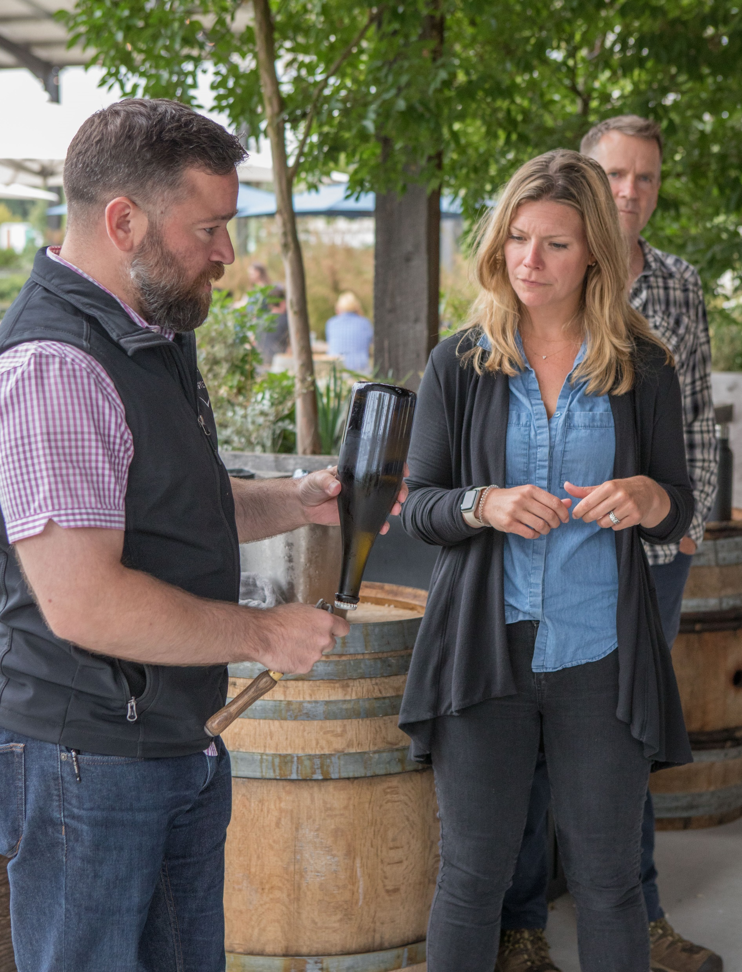
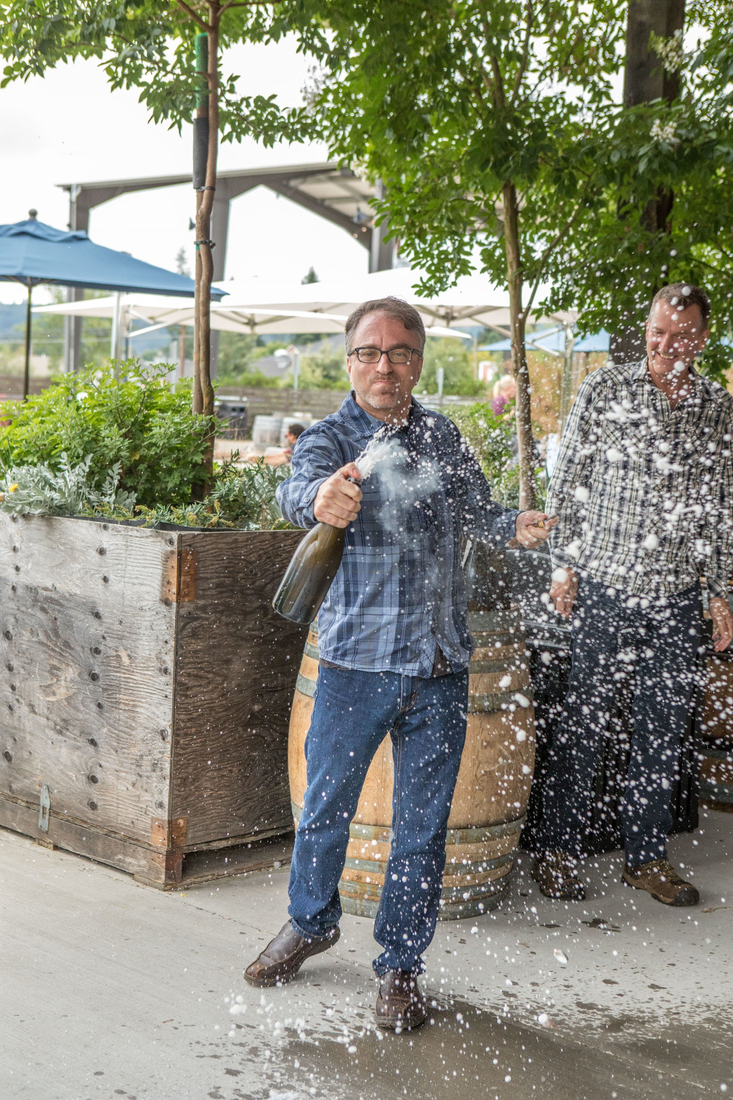
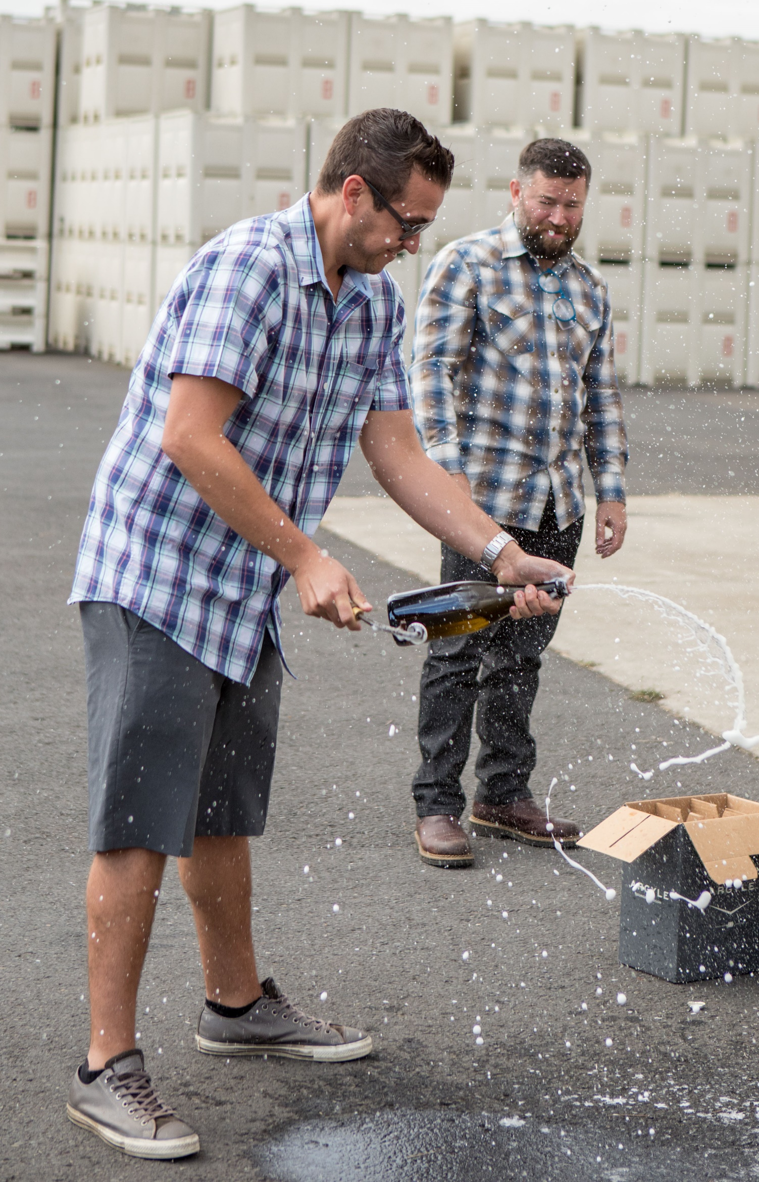
Steps for Disgorging
Upon delivery of kit, invert bottles to be disgorged. The yeast will be suspended in the bottles and will need to settle before disgorging.
Put disgorge wines on point for at least one hour in ice bucket.
Disgorge with apron and eye protection and perform outdoors pointed in a safe direction.
4 steps: point bottle down – pop crown cap – thumb over opening – bring bottle upright.
Disgorge tools are hand made and limited in supply, please treat them with care and return promptly.
Remember: Pics or it didn’t happen.

Slide 6
Guidelines
Our wholesale partners were properly motivated during Argyle U and that motivation is being carried into their respective markets. There are a few guidelines that should be followed in order to maximize success with this program:
Dates for programs with on/off-premise accounts must be set before we send a kit
Means for returning the disgorging tool will be included in each kit and it must be returned in a timely manner
Whenever possible the regional rep should attend the scheduled program or at the very least coordinate a follow-up with the wholesale partner
There will be a link under Trade and Media on our website that will lead to collateral for program
Please provide photos from each event, send to craig@argylewinery.com
This program has been a long time coming and we are excited to be able share a little bit of the Argyle/Oregon experience with all our advocates around the country.
Go forth and splash some bubbles!!

